Slide 1
Vulcan Defect Status
Jan. 18, 2016
Tao Wu, Wen Yi Gao

Slide 2
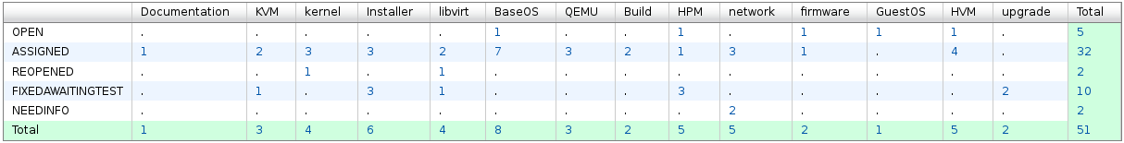
Vulcan - Open Defects
51 open defects including 10 defects in Fix-Awaiting-Test. No blocking defects for Vulcan.
20 defects new opened in the last two weeks. We solved 27 defects in the past two weeks.
Defect statistics:

Slide 3
Vulcan – High Priority Defects
Block bug:
  Bug 134362 - kvmibm-system-upgrade script hang / crash during execution
    Fix has been included in 1.1.1-rc1.4 release
    RYAN will verify this once test environment is ready.
Ship issue:
  Bug 134237 - Upgrade is missing licence acceptance logic required by legal
    The fix needs to be improved.
    New patch has been sent, now being under review.
  Bug 126365 - Default Network Performance is less than half of line speed
    Patches are ready and under review.
    Internal test results seem to be good.
  Bug 135193 - IPv6 Installation failure
    Under investigation.
  Bug 135030 - Vulcan RC1.4 Installer boot fails with dracut: FATAL: Invalid value for interface in ip= opts. When using VLAN
    Patch is ready.

Slide 4
Vulcan – All Defects
333 defects opened in the Vulcan Bugzilla until now

